Slide 1




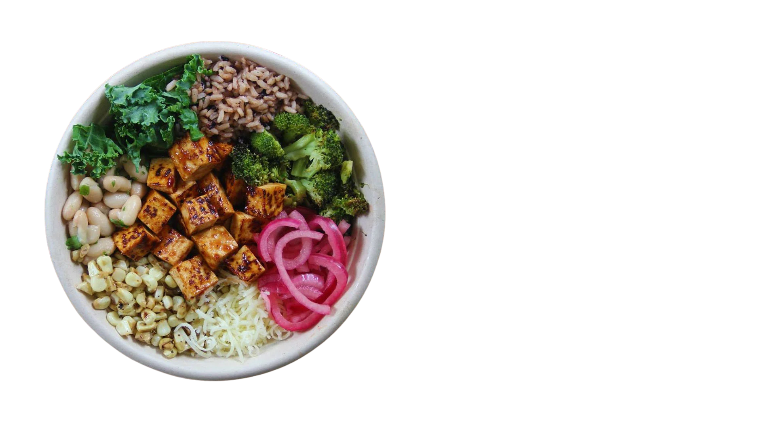



SYS 3060
ROOTS
A LUNCH QUEUE STUDY
FATIMA
AFILAL
MEKDES
ALEMAYEHU
RAHUL
SUNILKUMAR
ANDREW
JI
MAKANGO
CISSE
1

Slide 2

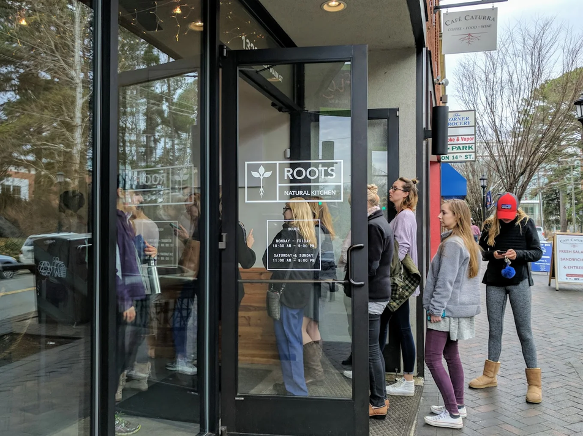
THE
PROBLEM
Student Time is Scarce
Peak waits during the 11:30-1:30 lunch window exceed the gap between classes, forcing students to skip out on eating at Roots.
Lost Revenue for Roots
Customers who see a long queue leave without ordering. Queue buildup directly affects throughput and daily sales.
2

Slide 3
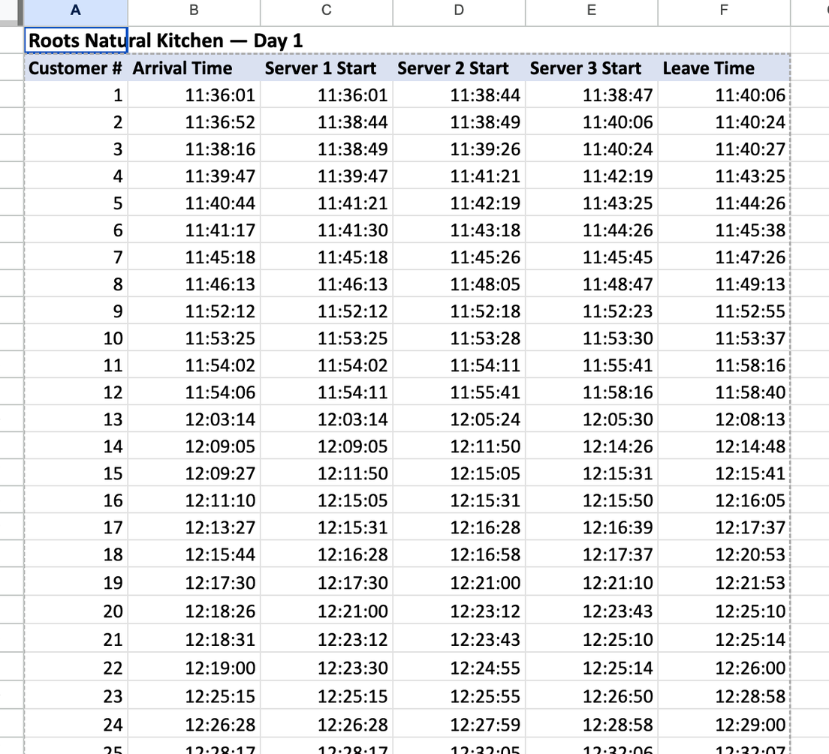
THE
SYSTEM & DATA
OBSERVED 3 WEEKDAY LUNCH RUSHES, RECORDED 6 TIMESTAMPS PER CUSTOMER:
ARRIVAL, START AT EACH OF THE 3 ASSEMBLY STATIONS, AND DEPARTURE.
TO MAKE OUR DATA BEHAVE
WE STAGGERED EACH CUSTOMER, EVEN IF THEY ARRIVED IN BATCHES.
FRIDAY FRENZY
DAY 3 WAS THE BUSIEST BY FAR WITH 48.5 CUSTOMERS PER HOUR! WITH THIS DEMAND, AVERAGE QUEUING DELAY ROSE TO 5.7 MINUTES.
DAY 01
DAY 03
50
53
DAY 01
TOTAL
44
147
3

Slide 4
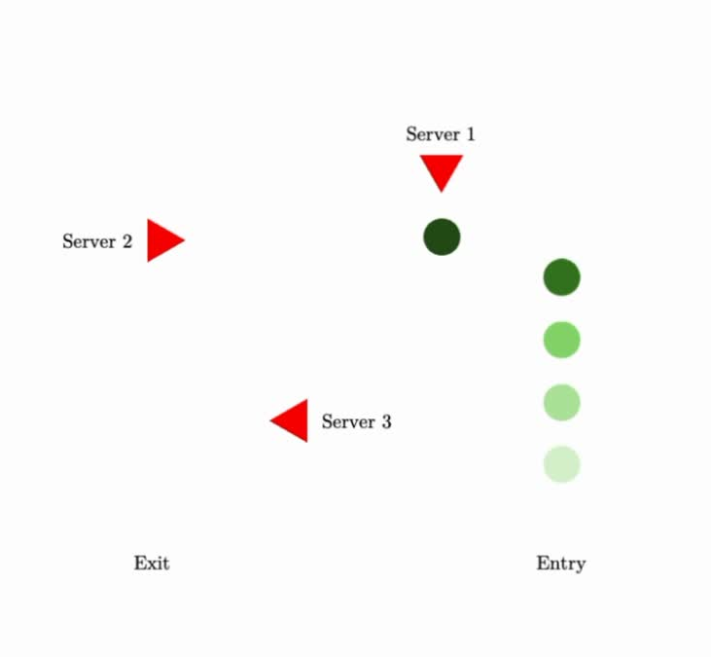
DATA
VALIDATION
M/M/1: Unstable at Peak Demand
λ = 48.5/hr but μ1 = 51/hr, ρ1 = 0.95 (Day 3)
As ρ → 1, queuing delay increases sharply.
M/M/3: Doesn’t Match System
Assumes customers pick any server freely.
Roots is sequential: base → toppings → checkout.
You cannot skip ahead to an open station.
Tandem 3 x M/M/M1: Supported
Service time flat at ~1.5 min for 1–3 concurrent →
3 independent stations. Beyond 3, congestion rises.
Sequential flow matches Roots' physical layout.
4

Slide 5

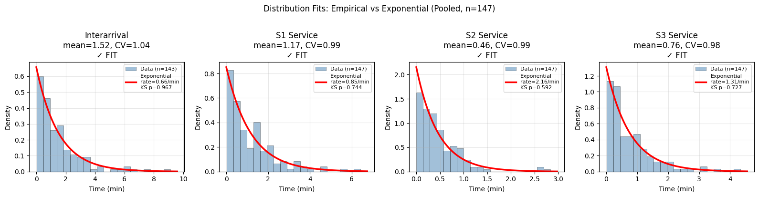
SYSTEM
VALIDATION
DISTRIBUTION FITTING
FIT EXPONENTIAL DISTRIBUTION TO
INTERARRIVAL TIMES
SERVICE TIMES (S1, S2, S3)
COMPARED EMPIRICAL HIST TO FITTED CURVES.
STATISTICAL CHECK
COMPUTED COEFF OF VARIATION:
INTERARRIVAL = 1.04
S1 = 0.99, S2 = 0.99, S3 = 0.98
CONSISTENT WITH EXPONENTIAL ASSUMPTION.
MODEL JUSTIFIED
VALIDATED ASSUMPTIONS FOR M/M/1 AT EACH STAGE → TANDEM (3 X M/M/1).
5

Slide 6
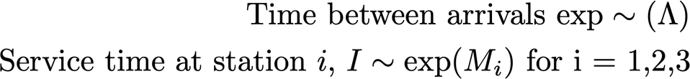
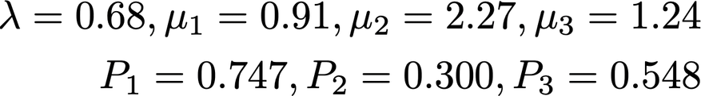
SYSTEM
MODEL
STATE DEFINITION:
EVENTS:
ESTIMATED PARAMETERS (RATES IN CUST/MIN)
6

Slide 7
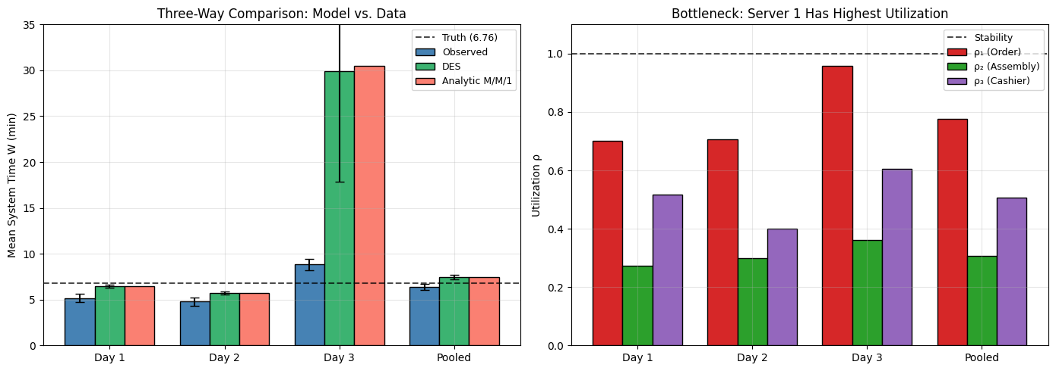
SYSTEM
PROBLEMS
BASELINE PERFORMANCE
DAY 1-2: MEAN SYS TIME ~ 5-7 MIN.
OBSERVED, SIMULATION, AND ANALYTIC RESULTS ALIGN.
PEAK DEMAND (DAY 3)
ARRIVAL RATE ~ 48.5 C/H. QUEUING DELAY INCREASES SHARPLY.
MEAN SYS TIME ↑30 MIN (MODEL).
KEY INSIGHT
AS UTILIZATION → 1
WAITING TIME INCREASES SHARPLY
7

Slide 8
SYSTEM
BOTTLENECK
UTILIZATION BY STAGE
S1: HIGHEST UTILIZATION ACROSS ALL DAYS.
S2, S3 CONSISTENTLY LOWER LOAD.
PEAK LOAD (DAY 3)
RHO1 ~ 0.95,
RHO2 ~ 0.36,
RHO3 ~ 0.61.
BOTTLENECK
SERVER 1 LIMITS SYS THROUGHPUT
QUEUE BUILDUP ORIGINATES AT S1
8

Slide 9
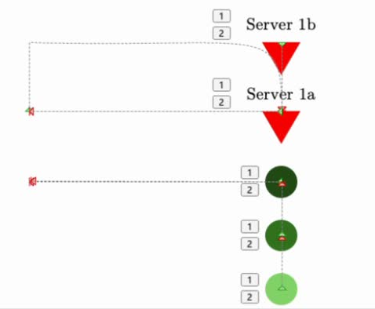
SYSTEM
IMPROVEMENT
CHANGE
ADD ONE PARALLEL SERVER AT STAGE 1
S1: M/M/1 → M/M/2
RATIONALE
TARGETS IDENTIFIED BOTTLENECK (S1)
REDUCES UTILIZATION AND QUEUE BUILDUP
EXPECTED EFFECT?
LOWER WAITING TIME
IMPROVED SYSTEM STABILITY DURING HIGH DEMAND
9

Slide 10
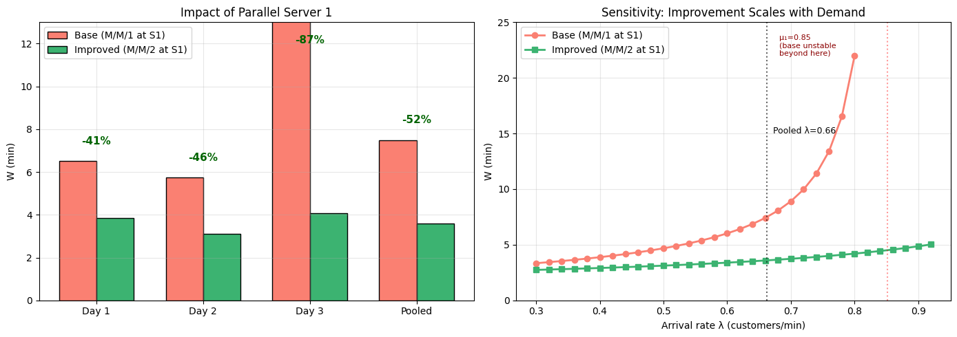
SYSTEM
FIXED?
WAIT TIME REDUCED
D1: -41%, D2: -46%, D3: -87%, POOLED: -52%
PEAK PERFORMANCE
MEAN SYS TIME: ~30 MIN → ~4 MIN
10

Slide 11
IMPROVEMENT IMPACT
Adding one line worker · 39.5 → 65 customers/hr
BEFORE · 39.5/hr
AFTER · 65/hr +1 staff
Consumer
surplus
Hourly revenue
Consumer
surplus
$533
→
$878
profit
grows
+$345/hr (+65%)
Profit 8%
$1.12
Profit 18%
$2.41
39.5 → 65 customers/hr
Food 30%
$4.05
Food 30%
$4.05
Hourly profit
Labor 27%
$44
$157
→
$3.65
Labor 18%
$2.48
+$113/hr (+256%)
Other 32%
Other 32%
extra labor: +$17/hr (12%)
$4.36
$4.36
2-hr lunch: $88 → $314/day

Slide 12
SYS 3060
NEXT STEPS
WHAT WE DID RIGHT!
IDENTIFIED S1 AS A BOTTLENECK
VALIDATED TANDEM M/M/1 MODEL
PARALLEL SERVER REDUCES WAIT TIME SIGNIFICANTLY.
LIMITATIONS
ARRIVAL DATA WAS STAGGERED TO REDUCE BUNCHING.
THIS ASSUMES A MORE STABLE LAMBDA AND EXPONENTIAL SERVICE TIMES.
DOESN’T CAPTURE BATCHING/SPIKES.
NEXT STEPS
MESSIER ARRIVAL PATTERNS.
TIME-VARYING DEMAND
VALIDATE IMPROVEMENT WITH REAL-WORLD PILOT!
-
13

